Slide 1
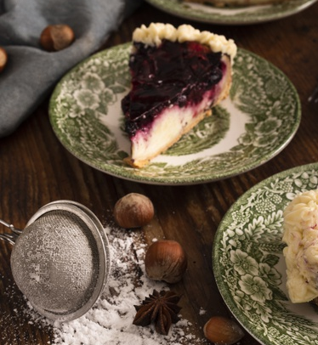
Magic Recipe
Yitian Yan, Siyi He, Minhao Li

Slide 2
Table of contents
Problem statement and the underlying motivation
03
01
Findings and human evaluation
02
04
Proposed methods
Q&A

Slide 3
Problem statement and the underlying motivation
01

Slide 4
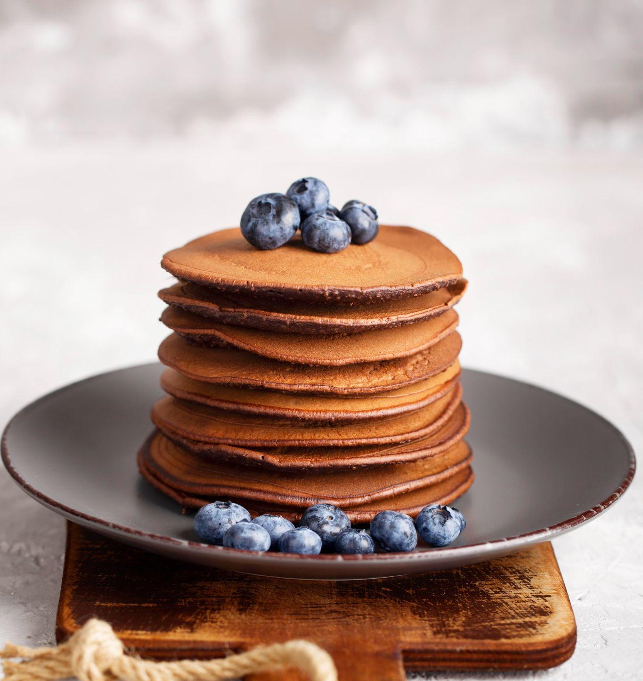
Problem Statement
How to leverage language models to generate recipes tailored to user preferences and available ingredients?

Slide 5
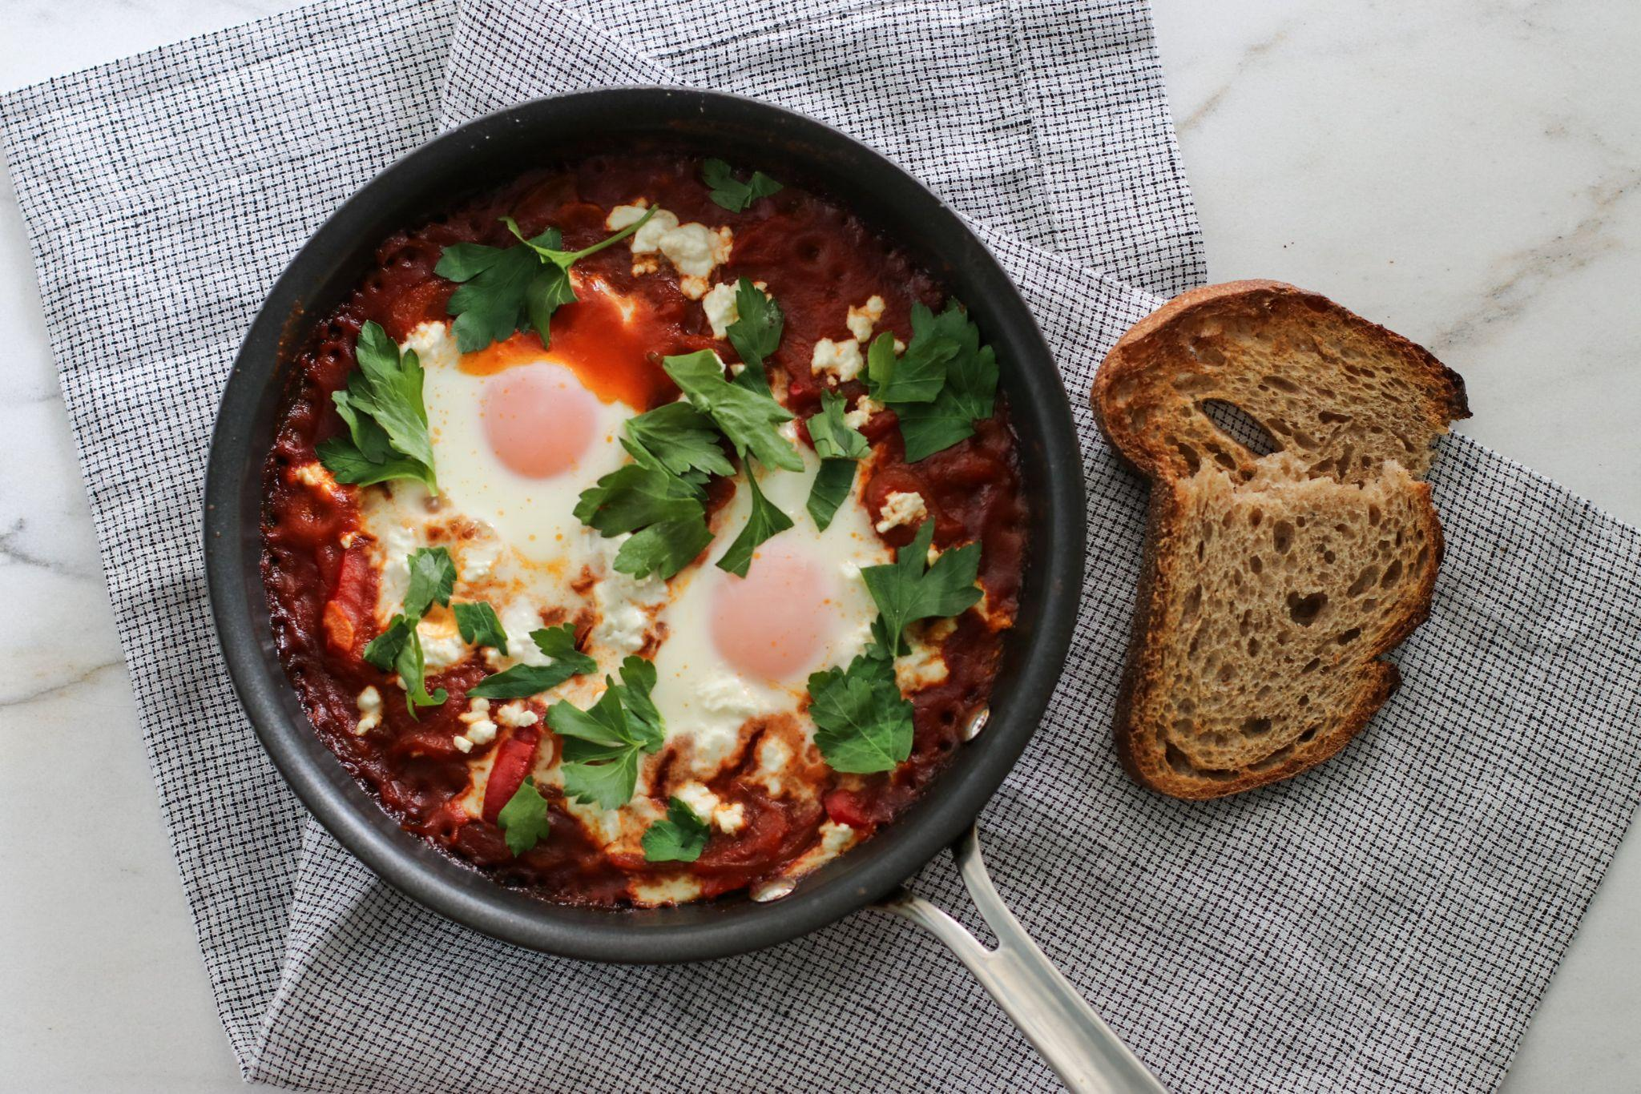
Input
Output
Hey, let’s say I have tomato, potato, and eggs. Can you give me some cooking idea
You can make Savoury Baked Eggs! Here is a quick recipe:
Preheat oven to 325 F
Boil peeled potatoes until tender ….
….
https://www.erinparekh.com/lifestyle/shakshuka

Slide 6
Motivation
Personalized Cooking Experiences
- Cater to health
- Fit the ingredients
Combining Culinary Arts and NLP
- Make the recipe creating process more automated and intelligent.
Challenges in Recipe Generation
- Cannot create recipes for dishes that go beyond the generic or common ones
- Overcome this by fine-tuning such pre-trained models with a large dataset that contains a variety of cuisines, thus generating recipes that maintains the culinary validity and appeal to the user’s taste.
Notes:
Today, we can see the trends that individuals not only want meals that cater to their health, but also fit the ingredients they already have. We want to tap into this demands by allowing uses to simply type down the items left in the fridge and receive a recipe that is both feasible and delicious.
Our project is at the intersection of the culinary arts and natural language processing. By merging this two fields, we aim to make the recipe creating process more automated and intelligent. We currently have a lot of apps that can generate recipes for you based on your available ingredients, eating preferences, and the amount of calories you want to take in. These kind of information is usually collected by asking users to take quick questionnaires. However, for impatient users like me, taking questionnaires can be a bit tedious, but if we can integrate this magic recipe bot into apps, it can help enhance the user experience by making users feel like they are really talking to a friend who knows their culinary tastes.
The main hurdle of the current model is that it cannot create recipes for dishes that go beyond the generic or common ones. For example, kungpao chicken is a popular cuisine but when we ask T5 how to make kungpao chicken, it simply answers “Preheat the oven to 375 degrees F. Place the chicken in a large bowl.” without more complexities. We aim to overcome by fine-tuning such pre-trained models with a large dataset that contains a variety of cuisines, thus generating recipes that maintains the culinary validity and appeal to the user’s taste

Slide 7
Section
02
Proposed Methods

Slide 8
Overview
Data preprocessing
Model training: Gemma, Flan-T5, and Bart

Slide 9
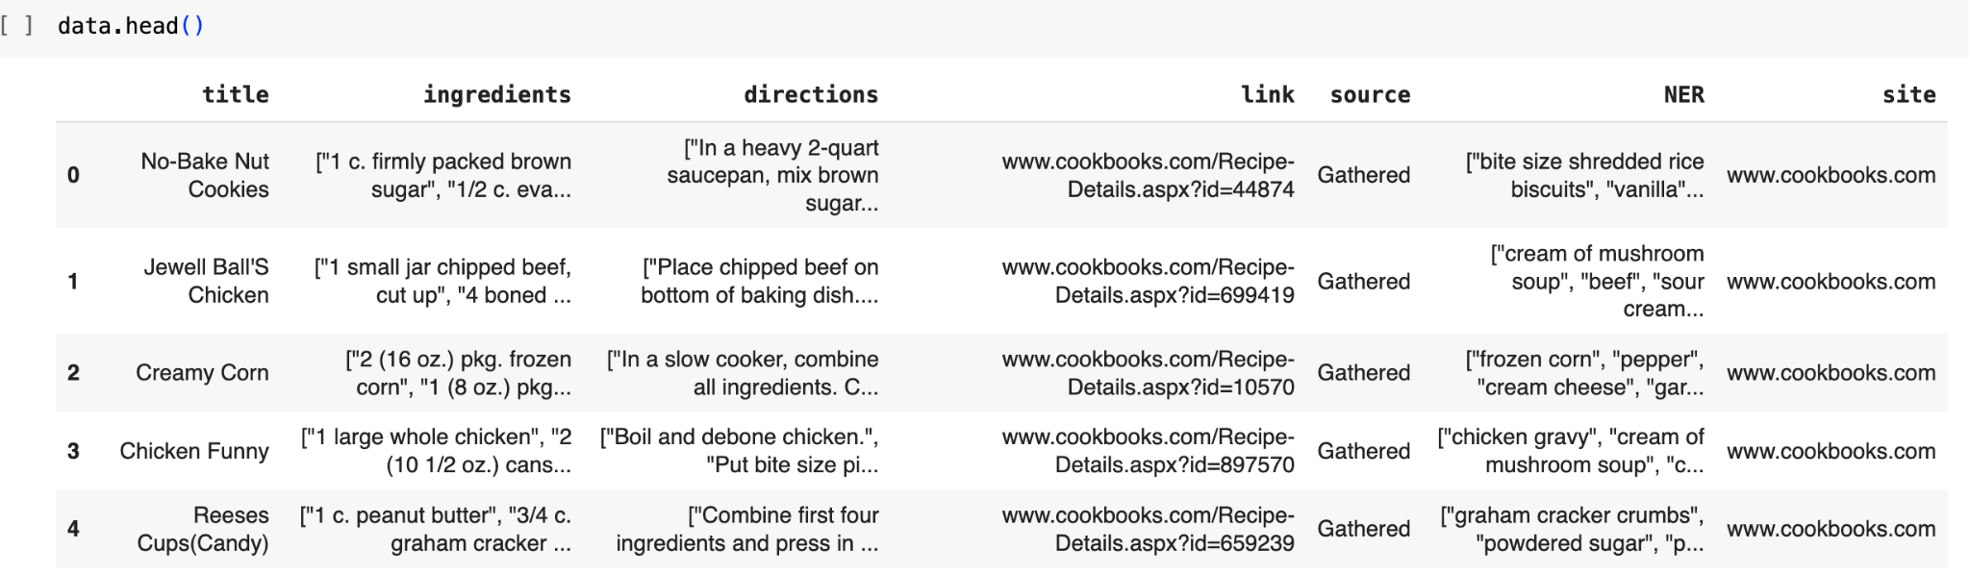
Data Preprocessing - preparing data for fine-tuning
Dataset: kaggle dataset. Drop redundant attributes; Convert String to iterable list; split it to train, dev, and test sets (8:1:1).
Notes:
We looked into a kaggle dataset of more than 50k entries that include different kinds of cuisines. Here is an overview of the dataset. As you can see, the dataset contains several key attributes like title, ingredients, directions, link, source, and NER which referring to the ingredients without specifying quantities. Since link and source are not relevant to this project, the first step of the data preprocessing is to drop these two columns. Moving on to the ingredients and directions attributes, they are represented in wrapped in angular brackets, not arrays that we might have expected. We need to employ some additional data processing techniques to convert them from strings to arrays, so they can become iterable. After going through these basic data preprocessing, we go ahead and split the dataset to train, dev, and test sets employing the 8:1:1 ratio.

Slide 10
Data Preprocessing - preparing data for fine-tuning (Cont.)
2. Data formatting
During the inference mode, the process of calling the model will be in this format:
“Please answer this question: <USER_QUESTION>”
Reformat the inputs:
Input: Please answer this question: I have <NER>. Give me some cooking ideas.
Label (ground truth): You can make <title> with <ingredients>. Here is the instructions: <directions>.
Notes:
We know that during the inference mode, the process of calling the model will be in this format:
“Please answer this question: <USER_QUESTION>”
Where the <USER_QUESTION> is the question the user would like the answer about.
Inspired by this, we want to restructure the original dataset so that it contains only two columns where one is for the input, which is the question, and the other is the ground truth, which is the answer to the question.

Slide 11
Example
Before:
After:

Slide 12
Data Preprocessing - preparing data for fine-tuning (Cont.)
3. Data tokenization
Library: Tokenizers
Max_length=128(input)/ 512(output)
Truncation=true

Slide 13
Model training
Gemma
Flan-T5
Bart
Light wight,
Text to Text
LLM by Google
an open-source, sequence-to-sequence, large language model
Denoising Sequence-to-Sequence Pre-training

Slide 14
Gemma
Text to text
Decoder-only
Light-weight -> 2b parameters
Uses instruction tuning:
Input: Text string, such as a question, a prompt, or a document to be summarized.
Output: Generated English-language text in response to the input, such as an answer to a question, or a summary of a document.
Challenge: structure prompts to meet different objectives.
Accessible through kaggle

Slide 15
Fine-tuning Gemma
Technique: LoRA (Low Rank Adaptation), rank = 4
More efficient with smaller training weights
The original LoRA paper found that fine-tuning with very low adapter rank between 4 and 32 could perform well ( Hu et al., 2021)
increasing rank further did not improve performance*
https://magazine.sebastianraschka.com/p/practical-tips-for-finetuning-llms

Slide 16
Training
Learning rate: 5e-5
Weight decay: 0.01 (regularization)
Batch size = 10
Epoch = 3
Input_length = 512
Time: 40 min on A100 GPU
How Weight Decay Works:
Loss = MSE(y_hat, y) + wd * sum(w^2)
I.e., WD constrains the model capacity and reduces overfitting by keeping weights smaller

Slide 17
Sample Output
How to make Kung-Pao Chicken?
The recipe for Kung-Pao Chicken is very simple and easy to make. You just need to follow the recipe step by step and you are done. This dish is very popular in China, where it is often served at Chinese restaurants. The recipe is a combination of Chinese and American cooking methods. The dish is usually prepared with chicken, but you can also use beef or pork. The ingredients for Kung-Pao Chicken are: Chicken breasts or thighs 1 tablespoon soy sauce 1 tablespoon oyster sauce 1 tablespoon ketchup 1 tablespoon hot sauce 1 tablespoon sugar 1 tablespoon cornstarch 1 tablespoon water 1 teaspoon salt Directions: In a small bowl, combine the soy sauce, oyster sauce, ketchup, hot sauce, sugar, cornstarch, and water. Add the chicken to the bowl and mix well to coat the chicken evenly. In a large skillet or wok, heat oil over medium-high heat. Once the oil is hot, add the chicken and cook until golden brown. Serve the Kung-Pao Chicken with rice or noodles. Enjoy!

Slide 18
Sample Output
Question:
I have some salmon and scallop. What can I cook for my family? Give me some ideas and instruction
Response:
I have some salmon and scallop. What can I cook for my family? Give me some ideas and instruction!
1 salmon fillet (about 4 oz.), cut into 8 pieces 1 1/2 lb. scallops, cooked (about 12-15 pieces) 3 tbsp. butter 1 tbsp. minced chives or scallions 3 tbsp. mayonnaise 1 tsp. minced fresh dill Salt and pepper, to taste
Preheat oven to 300 degrees. Line a large baking tray with parchment paper. Pat salmon dry and sprinkle with salt and pepper. In a small bowl, mix the butter, chives, mayonnaise and dill until combined. Spread mixture onto salmon and bake for 20-25 minutes, until fish flakes easily when pressed with a fork. Place scallops on prepared baking tray and cook for 10-12 minutes, turning once, until golden brown.

Slide 19
Flan-T5
Why?
a powerful Sequence-to -sequence language model
Super-lightweight (250M)
Instruction fine tuning: Please answer the following question. What is the boiling point of Nitrogen? - -320.4F
Notes:
For a quick recap, T5 is a encoder-decoder model pre-trained on a mixture of unsupervised and supervised tasks and for which each task is converted into a text-to-text format. Given that T5 can be adapted to a wide range of tasks including translation, text classification, and question answering, we think that it might be a good idea to try T5 since we are building a question-answering model.
The difference between Flan-T5 and T5 is that Flan-T5 is trained to follow instructions by incorporating task-specific instructions into the training process. For example, if you want to ask Flan-T5 “What is the boiling point of Nitrogen?”, you need to prefix it with Please answer the following question, and the Flan-T5 would answer the boiling point of nitrogen is -320.4F. Since Flan-T5 is created by applying instruction fine tuning on the original T5 model with datasets that include tasks like question-answering, Flan-T5 should outperform T5 in question-answering which makes it a good candidate for our project.
The other thing we ne

Slide 20
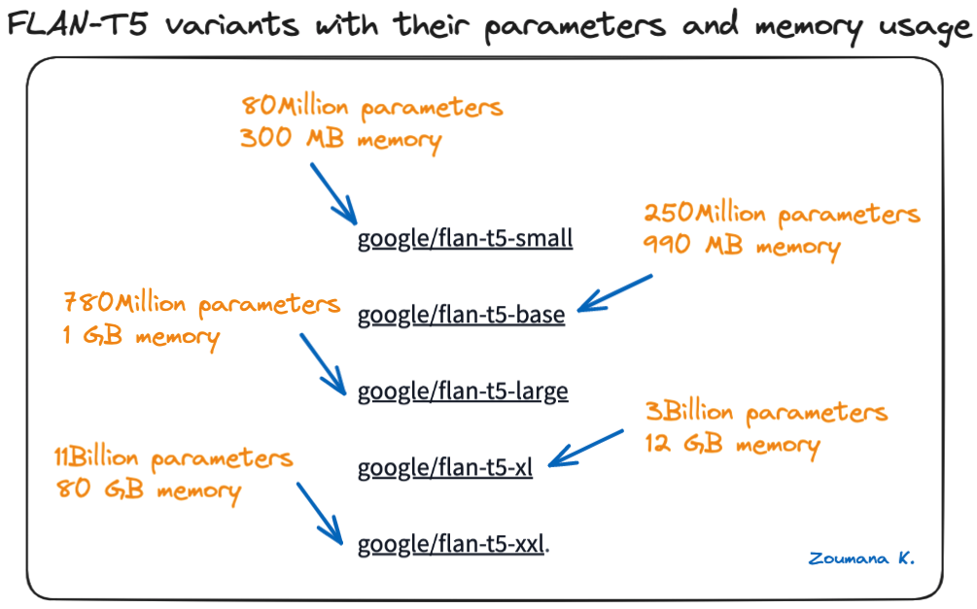
Flan-T5(Cont.)
FLAN-T5 models are available on Hugging Face
An NVIDIA A100 GPU → flan-t5-base
250 million
Parameters:
- learning_rate=3e-4,
- batch_size=8,
- num_train_epochs=2,
- weight_decay=0.01
Training time: 30 minutes on A100 GPU
Notes:
We import the Flan-T5 model from hugging face. There are a lot of Flan-T5 variants and we end up using flan-t5-base because it comes with 250 million parameters and 990 MB memory which can be handled by the NVIDIA A100 GPU.
An NVIDIA A100 GPU is being used for this experimentation, and the google/flan-t5-base model will strike a balance between computational efficiency and performance compatibility.
Here is the list of parameters we’ve used for training the model. We tried different combinations of parameters and it turns out that this set of parameters lead to a better performance.

Slide 21
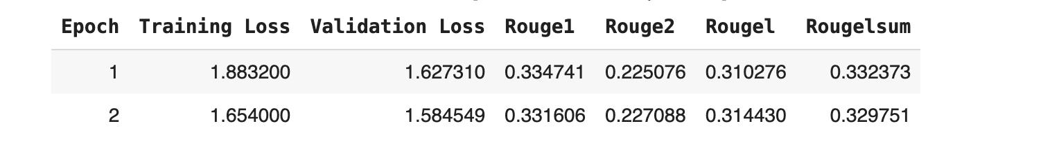
Flan-T5 Result
Training Loss: 1.654000
Evaluation Loss: 1.584549
Notes:
Here is the result. Over the course of two epoches of training, training loss goes down from 1.88 to 1.65 and the evaluation loss goes down from 1.62 to 1.58. The rouge score is also increasing as the training goes on, indicating that the output sequence is progressively aligning more closely with our ground truth data.

Slide 22
Flan-T5 Sample output
Example 1:
answer the question: How to make kung-pao chicken
You can make Kung-Pao Chicken. Here is the recipe : Cook chicken in a large skillet until done. Drain off excess fat. Add chicken to skillet. Add kung-pao chicken. Cook until chicken is done.
Example 2:
answer the question: I have some salmon and scallop. What can I cook for my family? Give me some ideas and instruction.
You can make Salmon And Scallop Casserole. Here is the recipe : Cook salmon and scallops in a large skillet until tender. Drain and set aside. Combine salmon and scallops in a large bowl. Mix together and pour over salmon and scallops. Bake at 350° for 30 minutes.

Slide 23
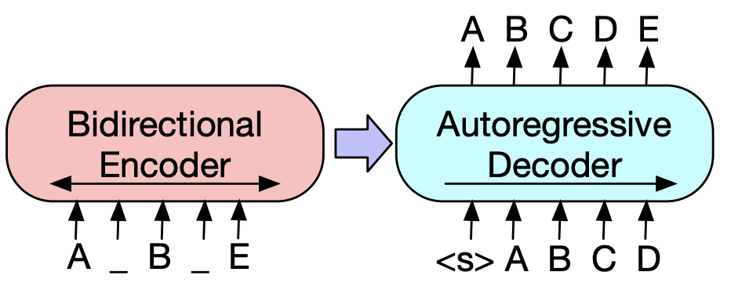
Bart
Why using bart:
bidirectional encoder allows it to understand context from both directions
The autoregressive decoder excels at generating coherent and contextually relevant text
robust pre-training and fine-tuning allow it to handle the diverse structure of recipes
BERT (Bidirectional Encoder Representations from Transformers) and GPT (Generative Pretrained Transformer) architectures
standard Transformer-based neural machine translation framework
Lewis, Mike, et al. "BART: Denoising Sequence-to-Sequence Pre-training for Natural Language Generation, Translation, and Comprehension." Facebook AI
Notes:
BART combines the strengths of two powerful architectures in the NLP world: BERT, which stands for Bidirectional Encoder Representations from Transformers, and GPT, or Generative Pretrained Transformer. But what makes BART uniquely suited for our task?
First, BART's bidirectional encoder. Unlike unidirectional models that only learn context in one direction, BART absorbs context from both ends of the text. For a recipe, this means understanding not just what ingredients have been mentioned, but also what cooking steps might come next, a key component in generating coherent instructions.
Moving to the decoder side, BART employs an autoregressive decoder. This means it generates text one word at a time, much like writing a recipe by hand. It crafts text that flows naturally, which is exactly what we need when explaining a recipe that's easy for others to follow.
Another aspect of BART is its robust pre-training and fine-tuning capabilities. It was pre-trained on vast amounts of text to understand language deeply and then fine-tuned, in our case, on a corpus of recipes. This enables BART not just to generate any text, but to generate text that sticks to the rich structure and style of culinary expressions.
At the bottom of this slide, you'll see a citation from the original paper by Lewis et al., which introduced BART. It's a compelling read for those who want to dive into the technical intricacies of the model.
To sum up, using BART for recipe generation means harnessing a model that understands the subtle nuances of language from large-scale data training and then refining its palate to the gourmet tastes of culinary arts. Now, let's take a closer look at how we fine-tuned BART to dish out delectable recipes that could potentially make it to your kitchen.

Slide 24
Bart
Output
Parameters
num_train_epochs=3,
per_device_train_batch_size=2
per_device_eval_batch_size=1,
gradient_accumulation_steps=8,
learning_rate=3e-4,
fp16=True,
Prompt: I have some salmon and scallop. What can I cook for my family? Give me some ideas and instruction.
Generated Text: you can make Seafood Dip with 1 can salmon, drained, 1 can cream of mushroom soup, 1/2 c. mayonnaise, 1 Tbsp. lemon juice. Here's the instruction : Mix all ingredients together and chill. Serve with crackers.
Evaluate
Train_loss: 1.3508

Slide 25
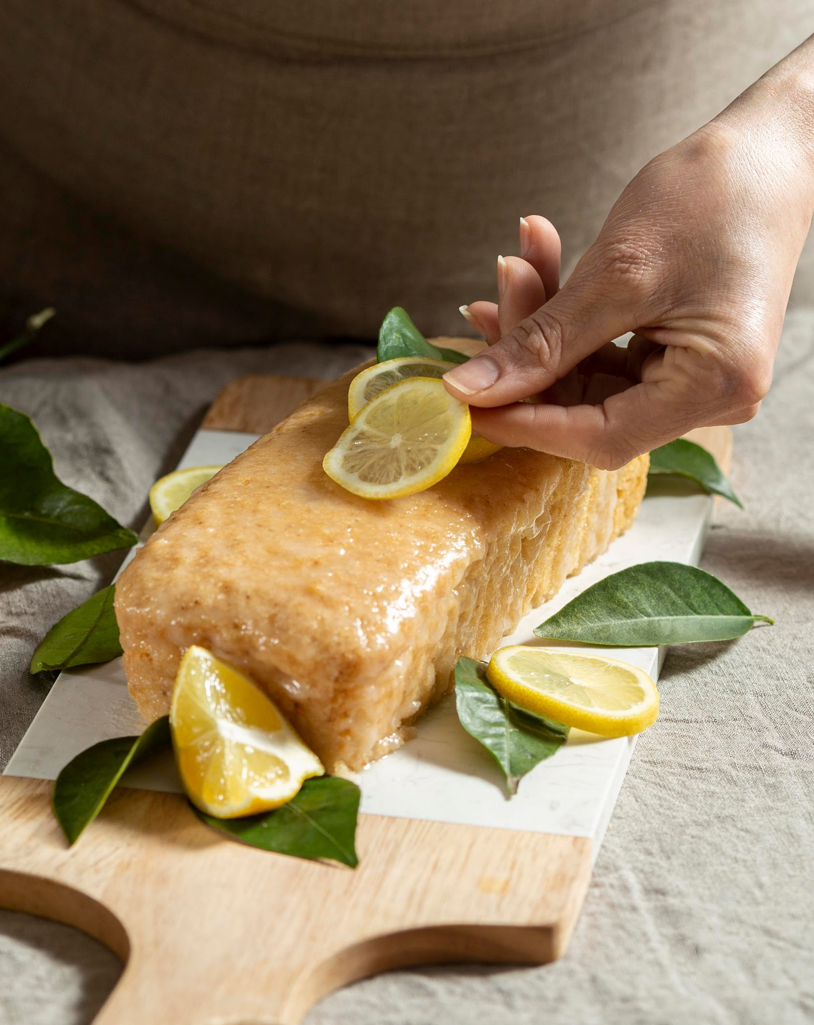
03
Findings and human evaluation

Slide 26
Auto Evaluation comparison
 | T5 | Gemma | Bart
Train_loss | 1.654000 | 0.7412 | 1.3077
Eval_loss | 1.584549 | 0.9876 | 1.9657
Notes:
Our focus here has been on optimizing these models for a recipe generation task.
As we know, evaluating language models isn't just about loss metrics; it's about understanding the quality of the text they produce. This is where ROUGE comes into play—a metric that evaluates the overlap between our model's output and a human reference.
Looking at the table, we have two types of loss: Train Loss and Eval Loss. Our Train Loss is based on the traditional method of how well the model predicts the training data. Eval Loss here is computed using the ROUGE metric, which gives us insight into how closely the machine-generated recipes match our human-crafted reference recipes.0
As we can see, T5 has a training loss of 1.654 and an evaluation loss of 1.584, indicating a decent fit to the data. However, when we shift our eyes to gemma, the numbers are significantly lower, with a training loss of 0.7412, suggesting it's learning well from the training set, and the evaluation loss is not yet visible on this chart.
Lastly, we have BART, which has a higher training loss of 1.3077 compared to gemma, and a higher evaluation loss as well, sitting at 1.9657.

Slide 27
Human Evaluation Metric
How to make kung-pao chicken?
Gemma
T5
Mars
How to make Kung-Pao Chicken? The recipe for Kung-Pao Chicken is very simple and easy to make. You just need to follow the recipe step by step and you are done. This dish is very popular in China, where it is often served at Chinese restaurants. The recipe is a combination of Chinese and American cooking methods. The dish is usually prepared with chicken, but you can also use beef or pork. The ingredients for Kung-Pao Chicken are: Chicken breasts or thighs 1 tablespoon soy sauce 1 tablespoon oyster sauce 1 tablespoon ketchup 1 tablespoon hot sauce 1 tablespoon sugar 1 tablespoon cornstarch 1 tablespoon water 1 teaspoon salt Directions: In a small bowl, combine the soy sauce, oyster sauce, ketchup, hot sauce, sugar, cornstarch, and water. Add the chicken to the bowl and mix well to coat the chicken evenly. In a large skillet or wok, heat oil over medium-high heat. Once the oil is hot, add the chicken and cook until golden brown. Serve the Kung-Pao Chicken with rice or noodles. Enjoy!
You can make Kung-Pao Chicken. Here is the recipe : Cook chicken in a large skillet until done. Drain off excess fat. Add chicken to skillet. Add kung-pao chicken. Cook until chicken is done. Add kung-pao chicken.
you can make Chicken And Rice Casserole with 1 lb. boneless, skinless chicken breasts, 1/2 c. kung-ao, 1 can cream of chicken soup, 2 cans cream of mushroom soup, 1 small can water chestnuts. Here's the instruction : Mix all ingredients together. Bake at 350° for 30 minutes.

Slide 28
Human Evaluation Metric: Rating criteria
Reasonability
Does the recipe seem logical and make sense? Are the ingredients and steps reasonable?
Coherence
Is the recipe well-structured and easy to follow? Do the steps flow in a coherent way?
Creativity
How creative and original does the recipe seem? Is it an interesting twist on existing recipes?

Slide 29
How to make kung-pao chicken?
 | Gemma | T5 | Bart
Output | How to make Kung-Pao Chicken? The recipe for Kung-Pao Chicken is very simple and easy to make. You just need to follow the recipe step by step and you are done. This dish is very popular in China, where it is often served at Chinese restaurants. The recipe is a combination of Chinese and American cooking methods. The dish is usually prepared with chicken, but you can also use beef or pork. The ingredients for Kung-Pao Chicken are: Chicken breasts or thighs 1 tablespoon soy sauce 1 tablespoon oyster sauce 1 tablespoon ketchup 1 tablespoon hot sauce 1 tablespoon sugar 1 tablespoon cornstarch 1 tablespoon water 1 teaspoon salt Directions: In a small bowl, combine the soy sauce, oyster sauce, ketchup, hot sauce, sugar, cornstarch, and water. Add the chicken to the bowl and mix well to coat the chicken evenly. In a large skillet or wok, heat oil over medium-high heat. Once the oil is hot, add the chicken and cook until golden brown. Serve the Kung-Pao Chicken with rice or noodles. Enjoy! | You can make Kung-Pao Chicken. Here is the recipe : Cook chicken in a large skillet until done. Drain off excess fat. Add chicken to skillet. Add kung-pao chicken. Cook until chicken is done. Add kung-pao chicken. | you can make Chicken And Rice Casserole with 1 lb. boneless, skinless chicken breasts, 1/2 c. kung-ao, 1 can cream of chicken soup, 2 cans cream of mushroom soup, 1 small can water chestnuts. Here's the instruction : Mix all ingredients together. Bake at 350° for 30 minutes.
rating | AVG 3.75 STDEV 1.06 | AVG 1.95 STDEV 0.94 | AVG 2.8 STDEV 1.15

Slide 30
I have some salmon and scallop. What can I cook for my family? Give me some ideas and instruction.
 | Gemma | T5 | Bart
Output | I have some salmon and scallop. What can I cook for my family? Give me some ideas and instruction! 1 salmon fillet (about 4 oz.), cut into 8 pieces 1 1/2 lb. scallops, cooked (about 12-15 pieces) 3 tbsp. butter 1 tbsp. minced chives or scallions 3 tbsp. mayonnaise 1 tsp. minced fresh dill Salt and pepper, to taste Preheat oven to 300 degrees. Line a large baking tray with parchment paper. Pat salmon dry and sprinkle with salt and pepper. In a small bowl, mix the butter, chives, mayonnaise and dill until combined. Spread mixture onto salmon and bake for 20-25 minutes, until fish flakes easily when pressed with a fork. Place scallops on prepared baking tray and cook for 10-12 minutes, turning once, until golden brown. | You can make Salmon And Scallop Casserole. Here is the recipe : Cook salmon and scallops in a large skillet until tender. Drain and set aside. Combine salmon and scallops in a large bowl. Mix all ingredients together and pour into a casserole dish. Bake at 350° for 30 minutes. | you can make Seafood Dip with 1 can salmon, drained, 1 can cream of mushroom soup, 1/2 c. mayonnaise, 1 Tbsp. lemon juice. Here's the instruction : Mix all ingredients together and chill. Serve with crackers.
rating | AVG 4.2 STDEV 0.833 | AVG 3.05 STDEV 1.05 | AVG 2.6 STDEV 1.04

Slide 31
Future Plan
Generation
Introducing more variance to the data
Exam on top-p, top-k and sampling generation
Reformat the original dataset to accommodate different types of question-answering
Attention
Token Masking
Incorporate attention to add more weight to ingredients
Random Masking and Structured Masking
Notes:
Attention:
Attention mechanisms assign different weights to different parts of the input sequence, determining how much 'attention' or importance the model should give to each part when predicting the next word.
We also want to see whether Attention helps the model associate specific ingredients with their respective steps. For example, it can learn that "whisking eggs" follows after "cracking eggs" by paying attention to the occurrence and position of these terms within the training data.
Token Masking:
I learn from the paper that BART is trained as a denoising autoencoder for pretraining sequence-to-sequence models. This means BART learns to restore the original text from a corrupted version where some tokens have been replaced with a [MASK] token.
And By predicting masked tokens, BART would learns to understand context and relationships between words. This is essential for tasks like recipe generation, where the model needs to understand how different ingredients and cooking steps relate to each other.

Slide 32
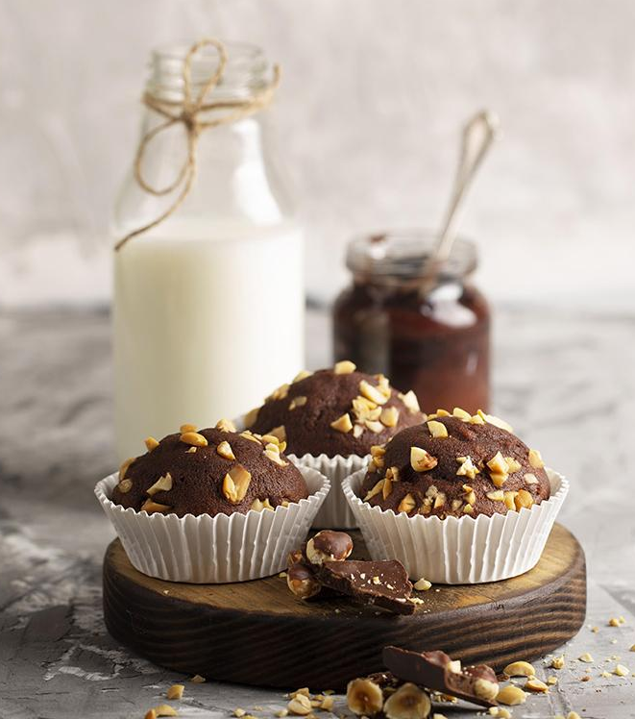
Q&A

Slide 33
Thank you!

